Slide 1
Generative Adversarial Network, NIPS 2014
Ian J. Goodfellow, Jean Pouget-Abadie, Mehdi Mirza, Bing Xu, David Warde-Farley, Sherjil Ozair, Aaron Courville, Yoshua Bengio

Slide 2


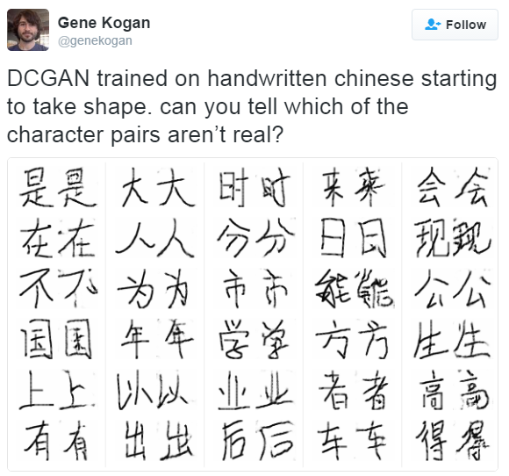






Turing Test

Slide 3
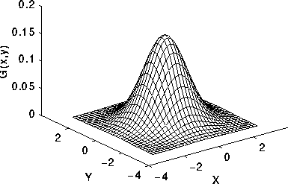


Generative?
…
Data:
Discriminative model: $p_{D}\left(x; θ_{D}\right)$
Generative model: $p_{G}\left(x;θ_{G}\right)$
True data distribution: $p_{data}(x)$
Train $p_{G}\left(x\right)≈p_{data}(x)$
$p_{data}(x)$

Slide 4





Generative Adversarial Network
Counterfeiters vs Police Game
IT’S FAKE MONEY!
IT’S REAL MONEY!

Slide 5


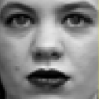

Generative Adversarial Network
Discriminative Model D
Generative Model G
…
…
…
…
…
…
p(z)
…
…
Sample x
Random noise z

Slide 6


Generative Adversarial Network
Discriminative Model D
Try to classify the sample x
D(x)=0 when x from Data
D(x)=1 when x from G (generator)
1
0
…
…
Differentiable function represented by a multilayer perceptron with parameters
…
…
…
…
sample x
from data
sample x
from G
…
Generative Model G
…
Try to generate sample x
As similar as the real data
…
p(z)
…
random noise z
…

Slide 7
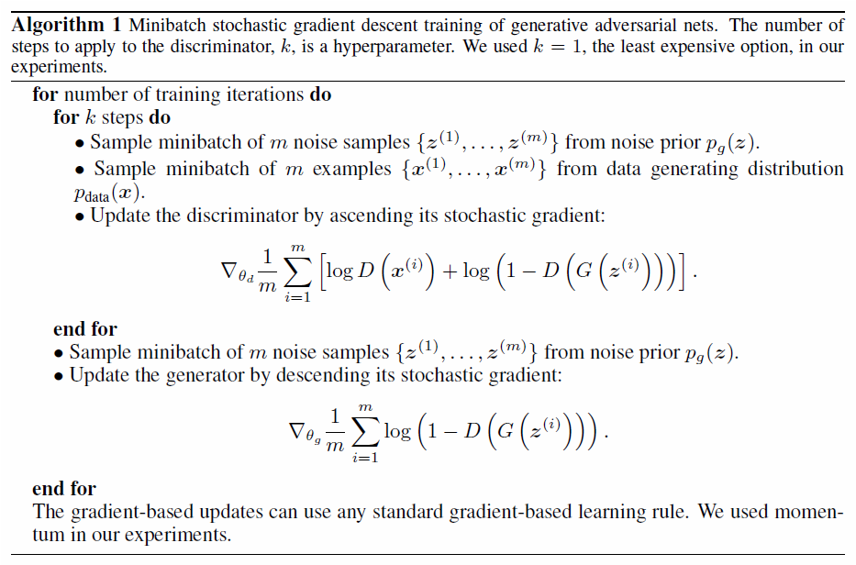


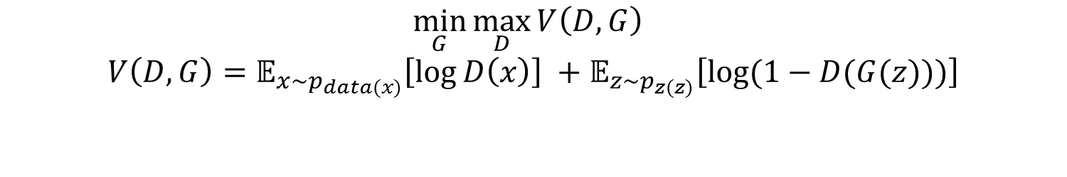
Generative Adversarial Network
$$\min_{G}{\max_{D}{V\left(D,G\right) }}$$
$$V\left(D,G\right)=𝔼_{x\sim p_{data(x)}}\left[\log{D\left(x\right)}\right] +𝔼_{z\sim p_{z(z)}}\left[\log{(1−D(G(z)))}\right]$$
Discriminative Model D
1
0
…
…
…
…
…
…
…
Generative Model G
…
…
…
p(z)
random noise z
…

Slide 8

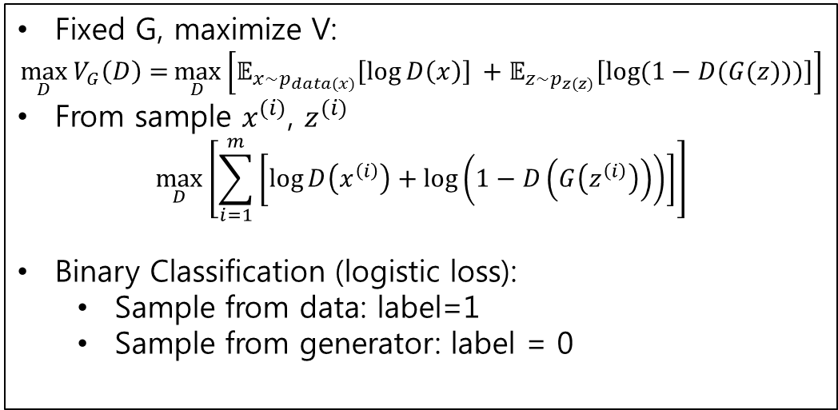
Generative Adversarial Network
$$\min_{G}{\max_{D}{V\left(D,G\right) }}$$
$$V\left(D,G\right)=𝔼_{x\sim p_{data(x)}}\left[\log{D\left(x\right)}\right] +𝔼_{z\sim p_{z(z)}}\left[\log{(1−D(G(z)))}\right]$$
Fixed G, maximize V:
$$\max_{D}{V_{G}\left(D\right)=}\max_{D}\left[𝔼_{x\sim p_{data(x)}}\left[\log{D\left(x\right)}\right] +𝔼_{z\sim p_{z(z)}}\left[\log{(1−D(G(z)))}\right]\right]$$
From sample $x^{(i)}$, $z^{(i)}$
$$\max_{D}\left[\sum_{i=1}^{m}{\left[\log{D\left(x^{\left(i\right)}\right)+\log\left(1−D\left(G\left(z^{\left(i\right)}\right)\right)\right)}\right]}\right]$$
Binary Classification (logistic loss):
Sample from data: label=1
Sample from generator: label = 0
Discriminative Model D
1
0
…
…
…
…
…
…
…
Generative Model G
…
Stochastic Gradient
…
…
p(z)
random noise z
…

Slide 9

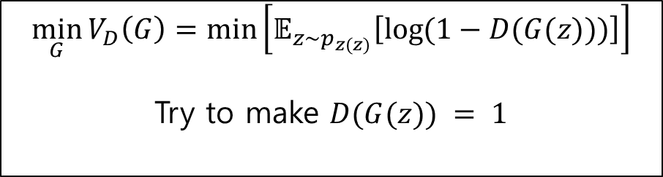
Generative Adversarial Network
$$\min_{G}{\max_{D}{V\left(D,G\right) }}$$
$$V\left(D,G\right)=𝔼_{x\sim p_{data(x)}}\left[\log{D\left(x\right)}\right] +𝔼_{z\sim p_{z(z)}}\left[\log{(1−D(G(z)))}\right]$$
Discriminative Model D
Fixed D, minimize V(G):
1
0
$$\min_{G}{V_{D}\left(G\right)=\min\left[𝔼_{z\sim p_{z(z)}}\left[\log{(1−D(G(z)))}\right]\right]}$$
Try to make $D(G(z)) = 1$
…
…
…
…
…
…
…
Stochastic Gradient
Generative Model G
…
…
…
p(z)
random noise z
…

Slide 10
Generative Adversarial Network
Update D
Update G

Slide 11
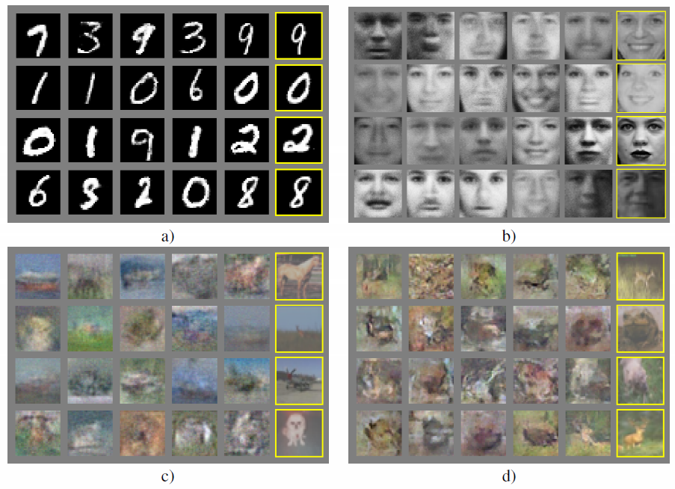
GAN Results
Nearest training example
Generated Samples

Slide 12
Unsupervised Representation Learning with Deep Convolutional Generative Adversarial Network, ICLR 2016.
Alec Radford, Luke Metz and Soumith Chintala

Slide 13


DCGAN
Deep Convolutional Network + GAN
Tricks for stable training
Experimental Analysis
Discriminative Model D
1
0
…
…
…
…
…
…
…
Generative Model G
…
…
…
p(z)
random noise z
…

Slide 14


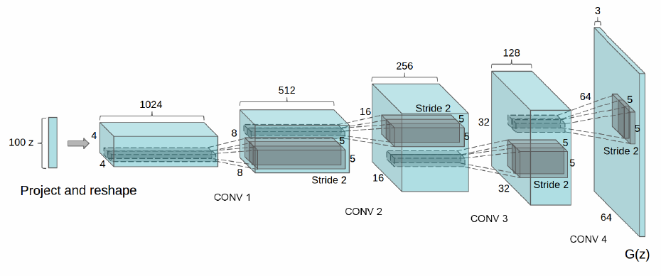
DCGAN
Discriminative Model D
1
0
…
…
…
…
…
…
Replace model’s network to CNN
Example of generator G
(same as D)
…
Generative Model G
…
…
…
p(z)
random noise z
…
z: uniform dist.

Slide 15
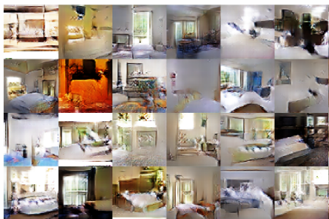
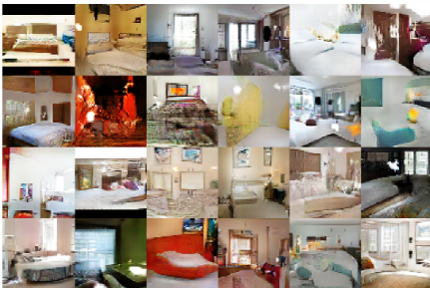
Experiments
LSUN – bedroom dataset
3 million training examples
Epoch #1
Epoch #5

Slide 16
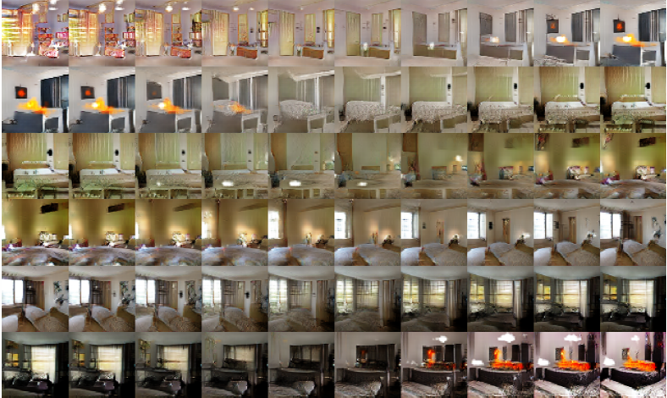


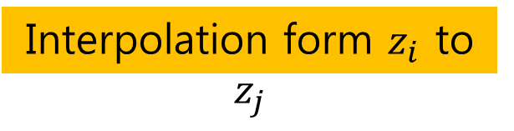
Experiments
Input noise z
Interpolation form $z_{i}$ to $z_{j}$
$$z_{i}$$
$$z_{j}$$

Slide 17
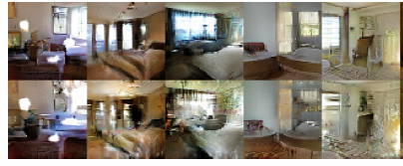
Experiments
Which activations(feature map) in CNN has representation of ‘window’?
At feature activations, assign neuron in the window region is 1, otherwise 0.
Logistic regression to find window-representative feature map.
Window feature map removal

Slide 18
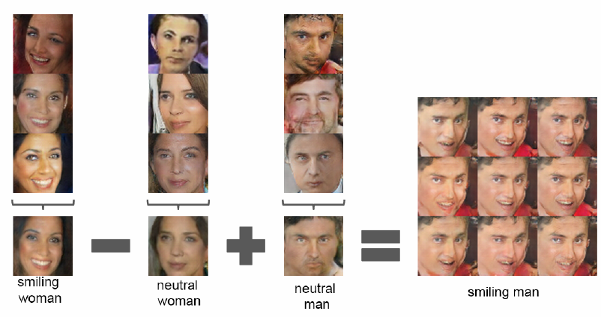
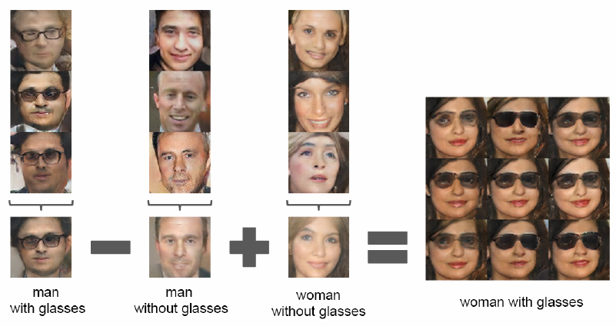
Experiments
Faces – scraped human face image from web
3 million images from 10,000 people.
Vector arithmetic

Slide 19
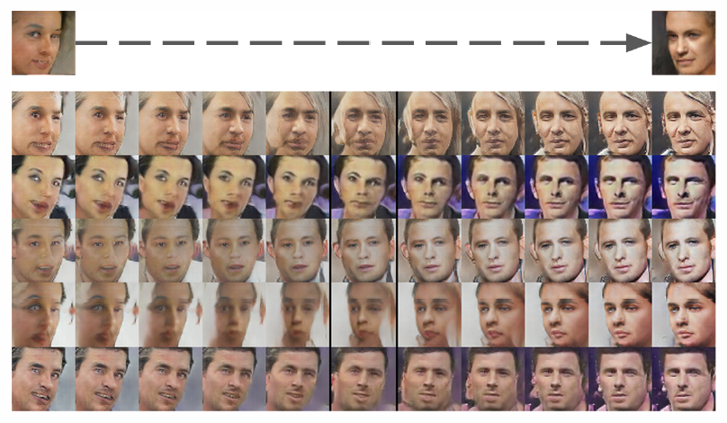
Experiments

